Slide 1
ROUND TABLE
Eternal Business. Real Life.

Slide 2
CONTENT

Slide 3
CURRICULUM

Slide 4
MAKE IT PERSONAL

Slide 5
OWN THE VALUE

Slide 6
PREP TO TEACH

Slide 7
LEAD TO FACILITATE

Slide 8
PRE-DISCUSS

Slide 9
HANGING QUESTIONS

Slide 10
THINK VISUAL

Slide 11
PERSONAL CHARGE

Slide 13
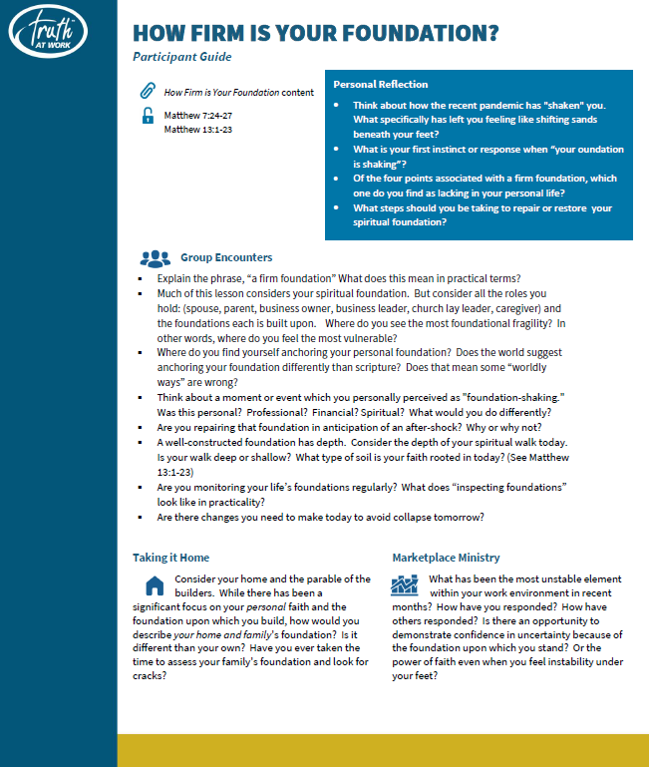

Slide 14
I NEVER GET TO
EVERY QUESTION

Slide 15
LEAN INTO
OBJECTIONS

