Slide 1
ROUND TABLE
Eternal Business. Real Life.

Slide 2
BEST PRACTICE

Slide 4
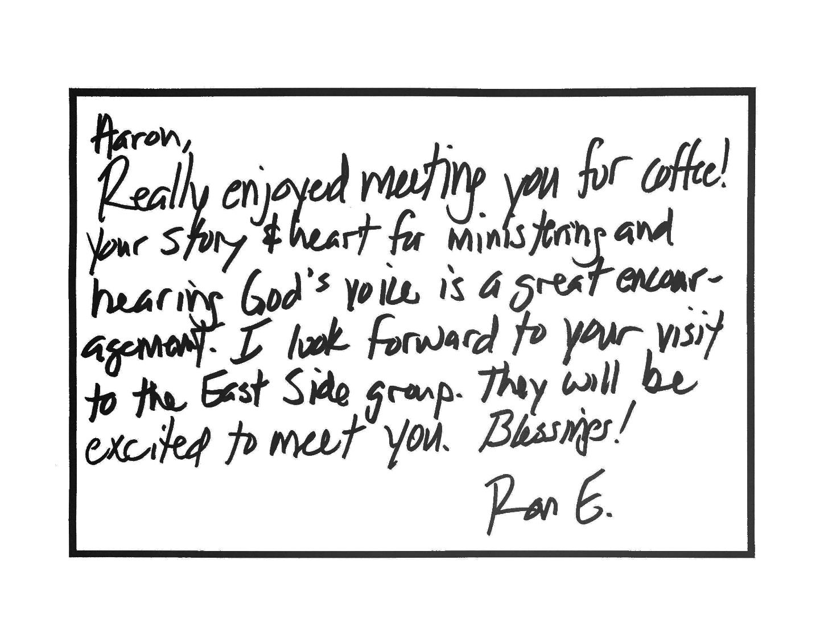

Slide 8
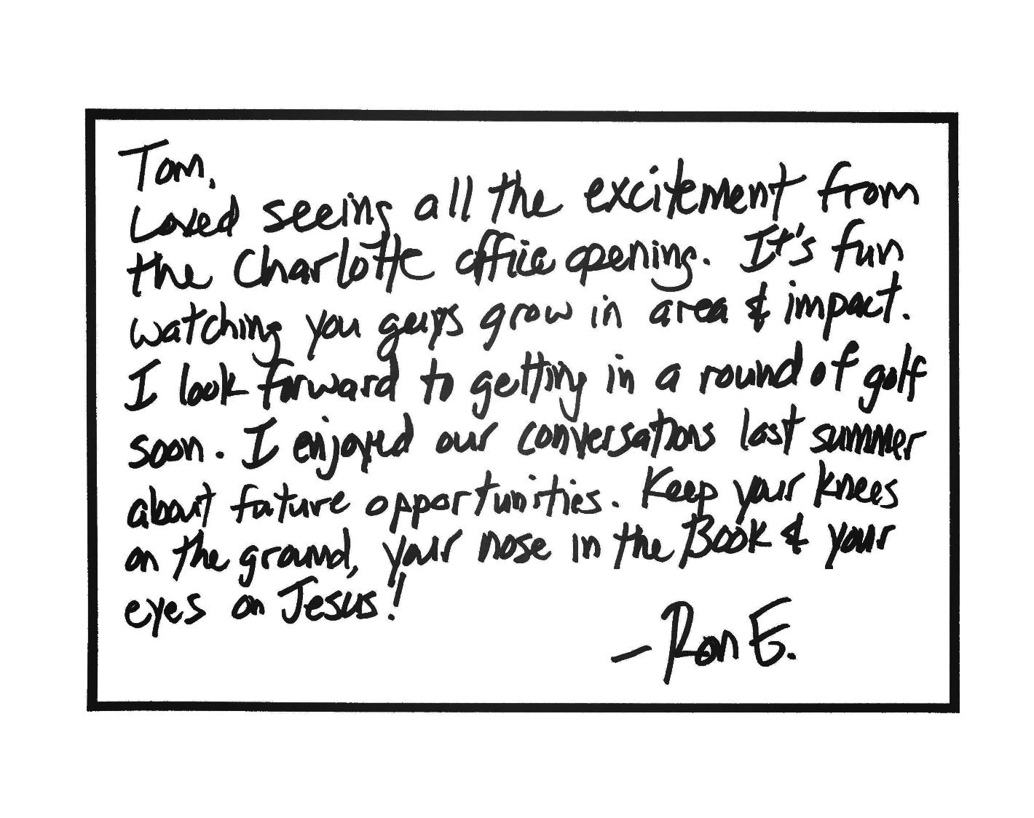

Slide 10
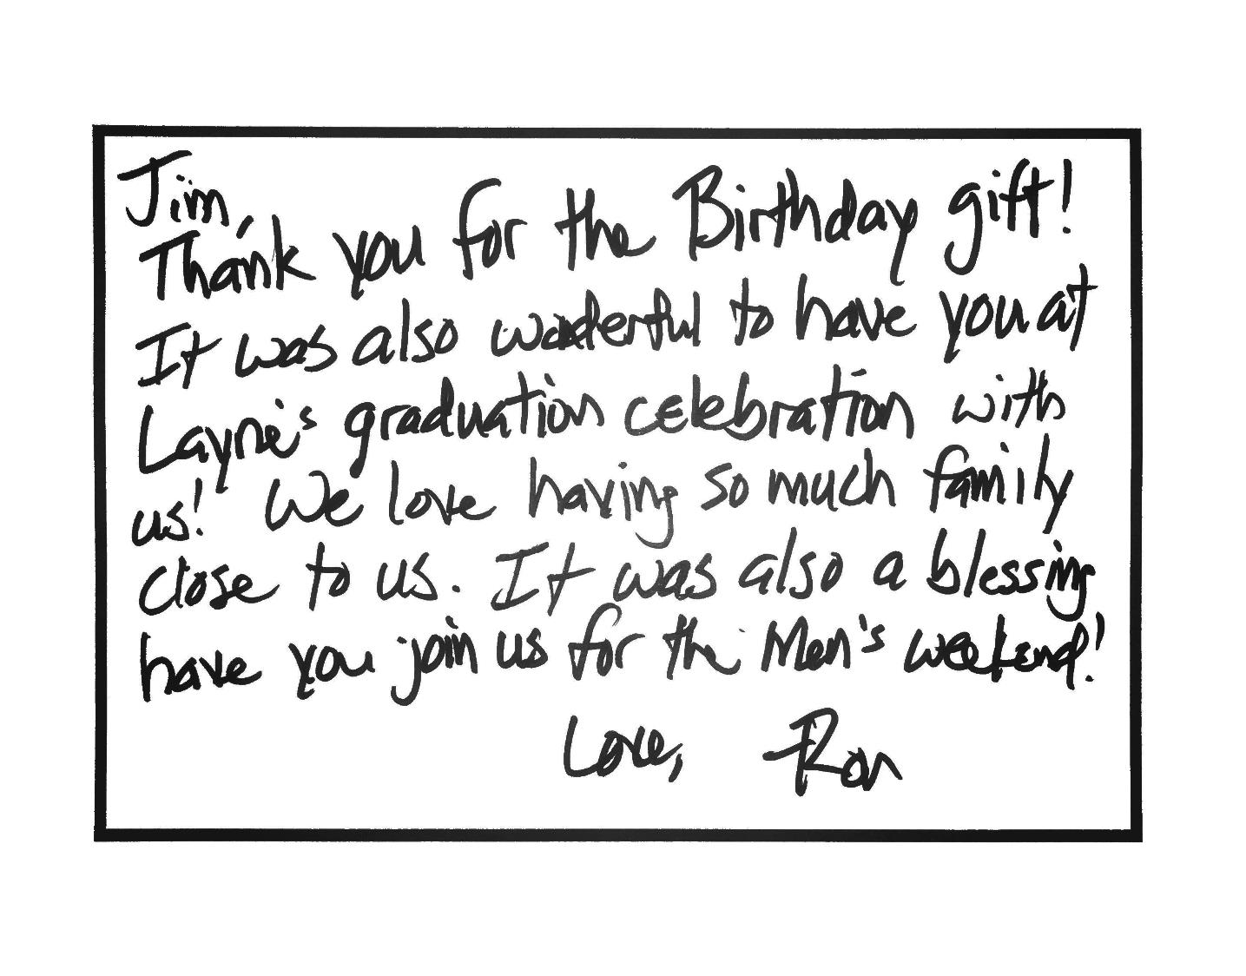

Slide 15
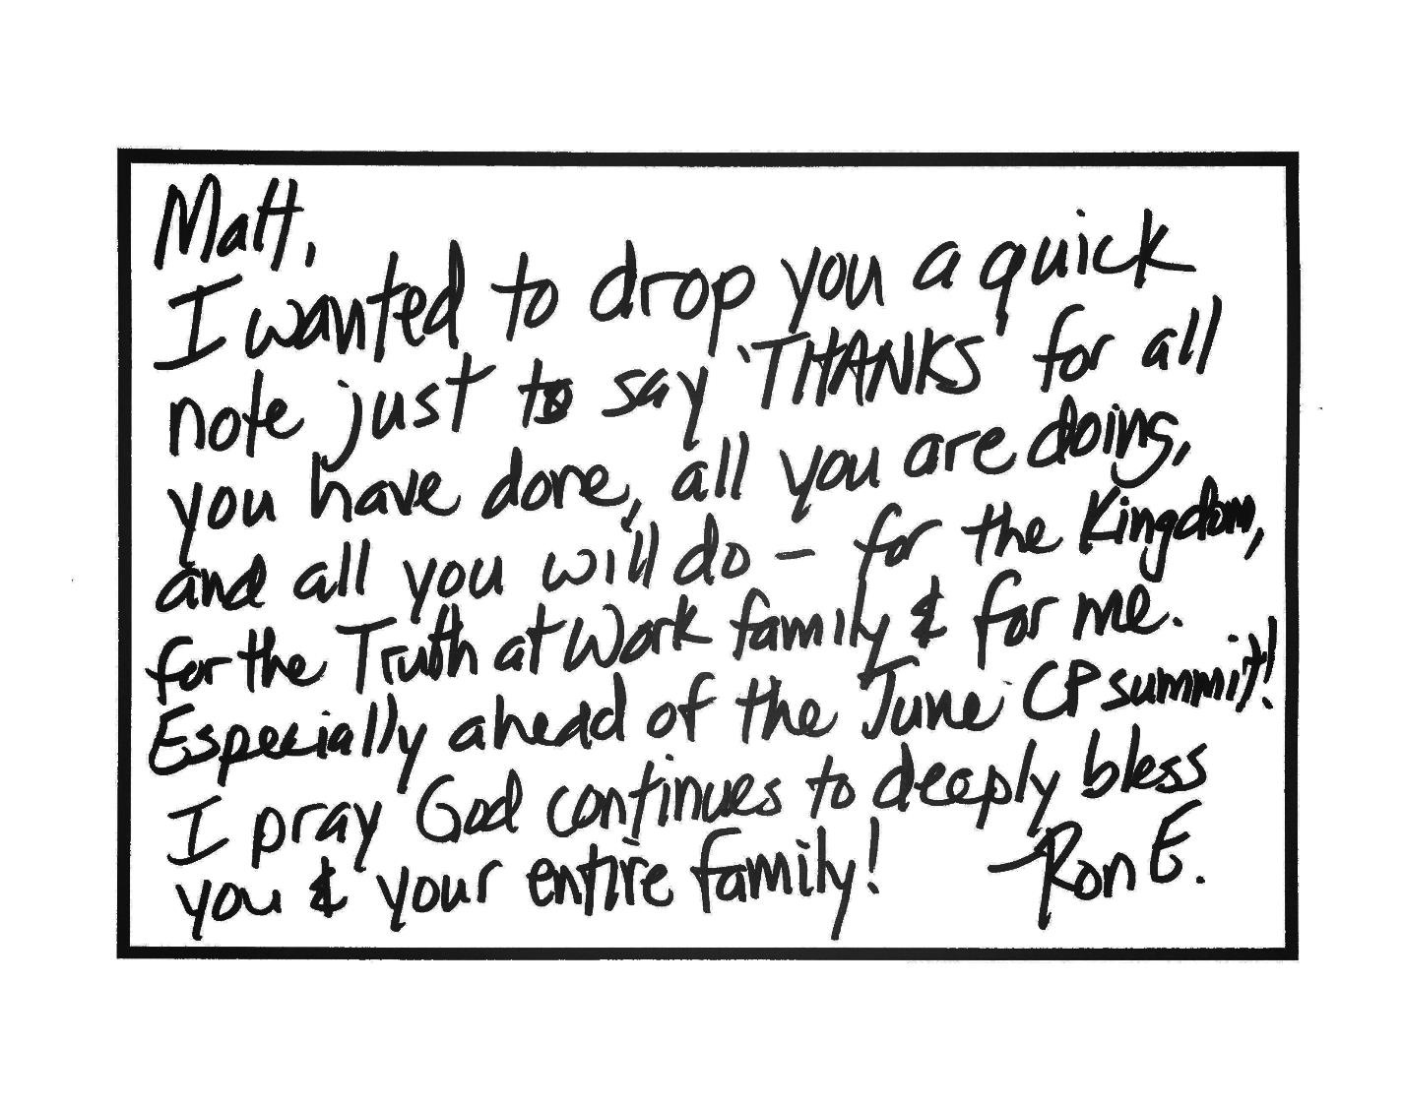

Slide 16
PROCESS

Slide 17
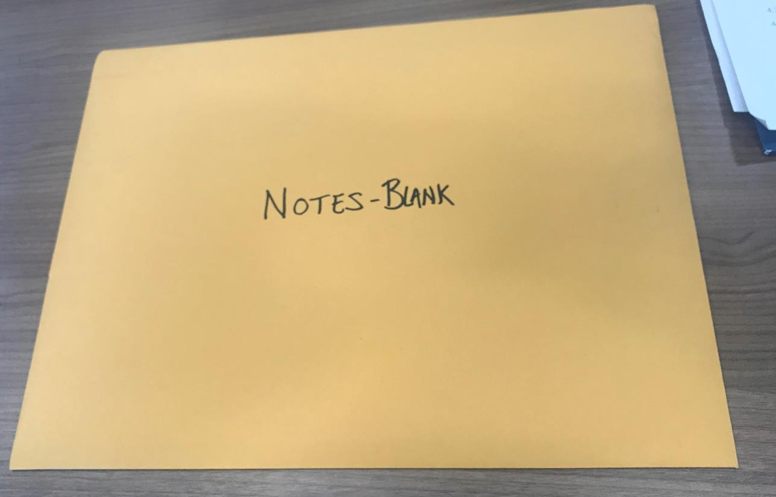
PROCESS

Slide 18
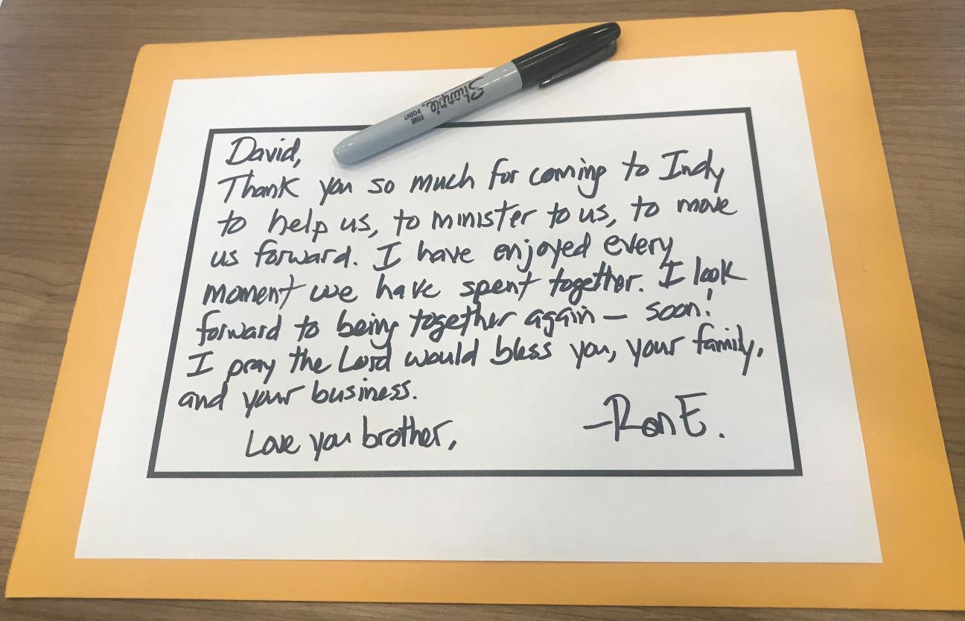
PROCESS

Slide 19
PROCESS

Slide 20
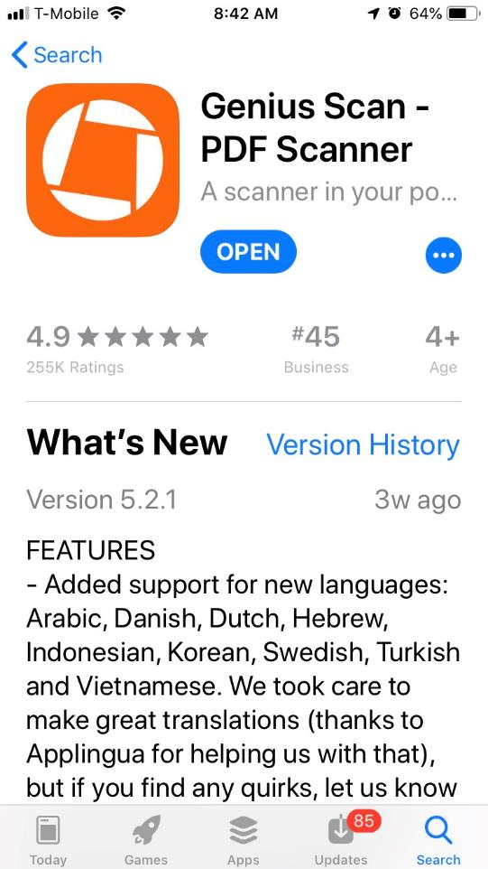
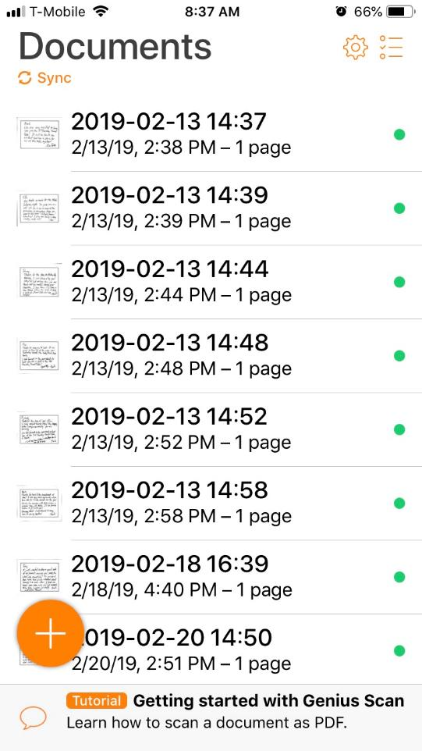
PROCESS

Slide 21
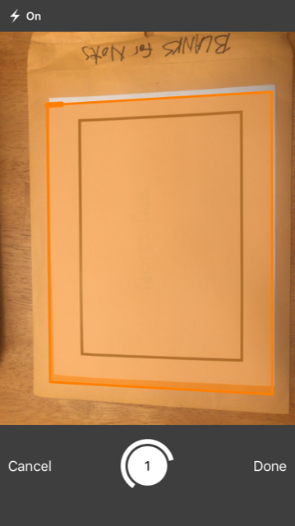
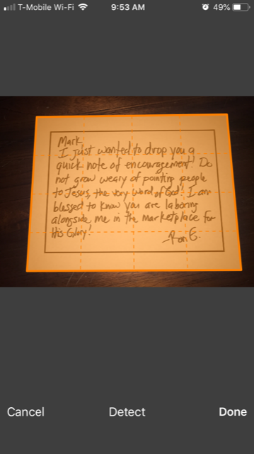
PROCESS

Slide 23
PROCESS

Slide 24
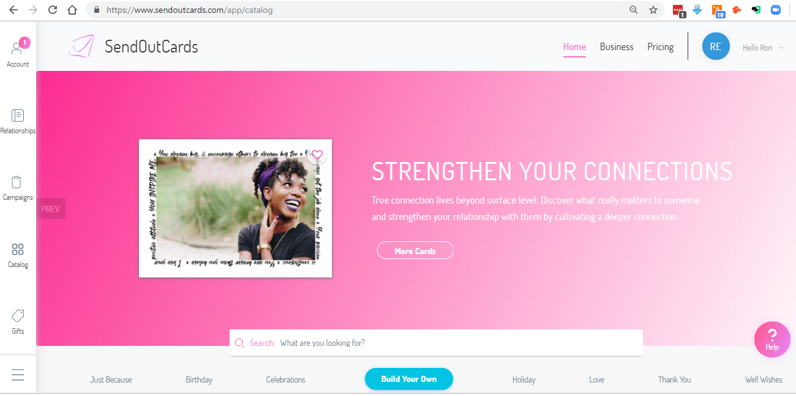
PROCESS

Slide 25
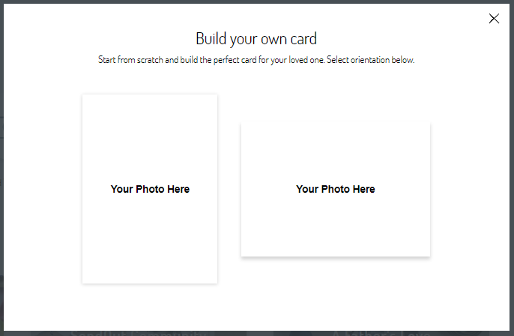
PROCESS

Slide 26
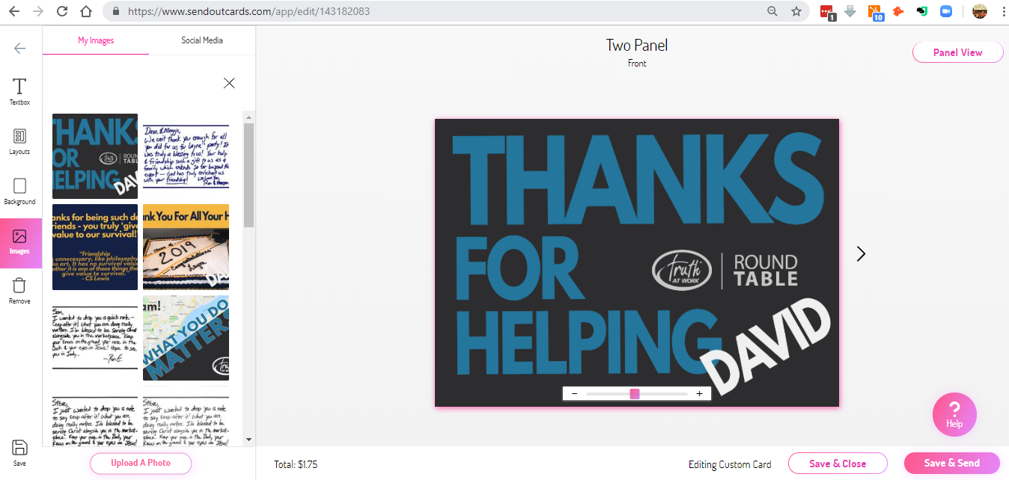
PROCESS

Slide 27
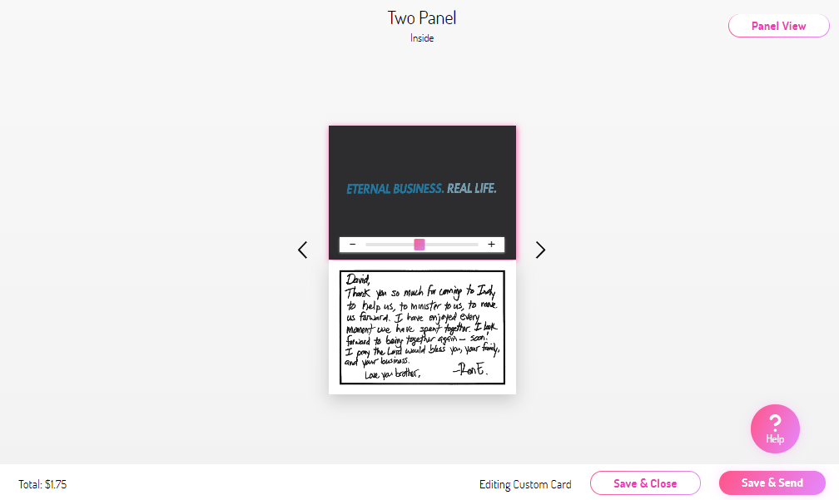
PROCESS

Slide 28
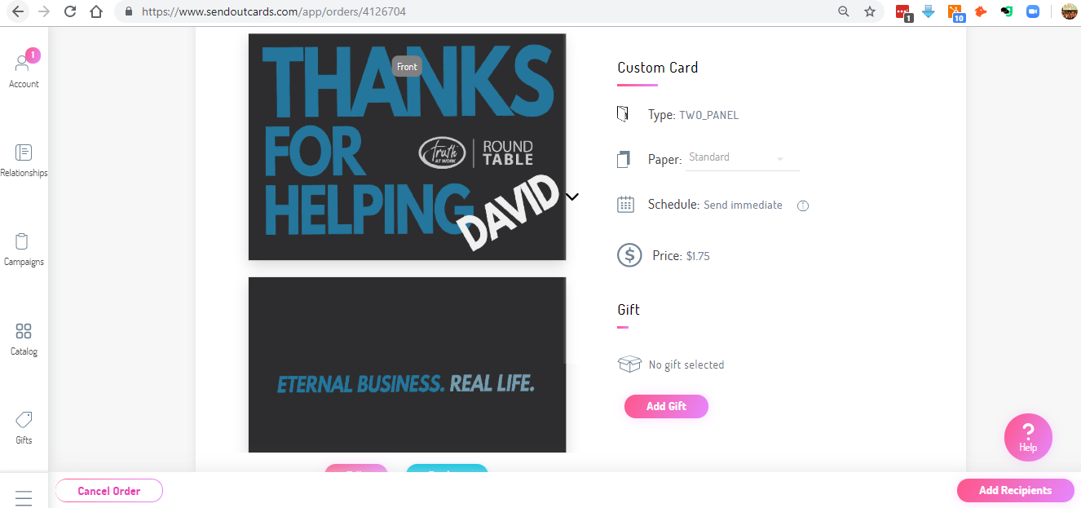
PROCESS

Slide 29
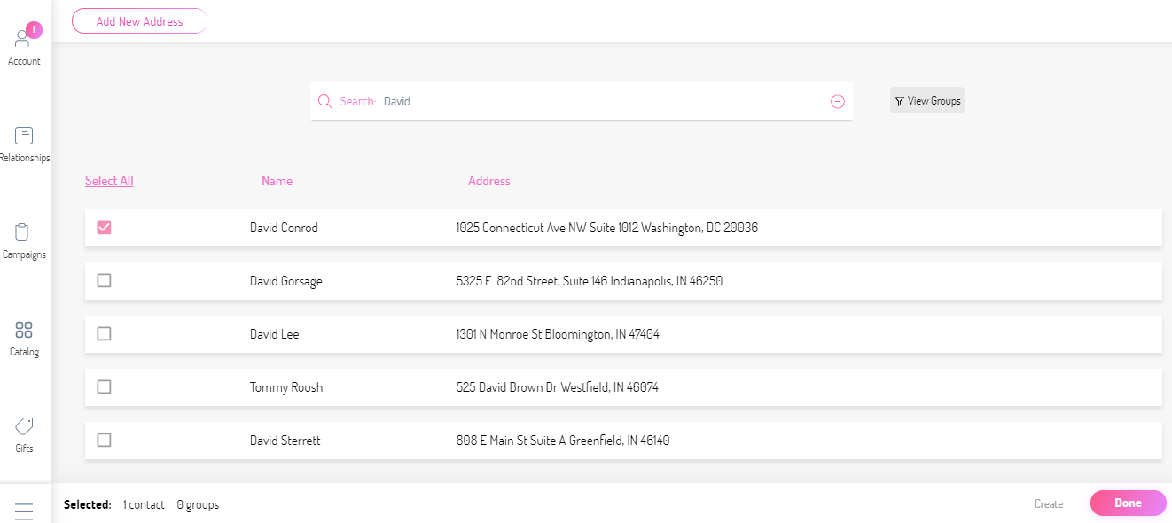
PROCESS

Slide 30
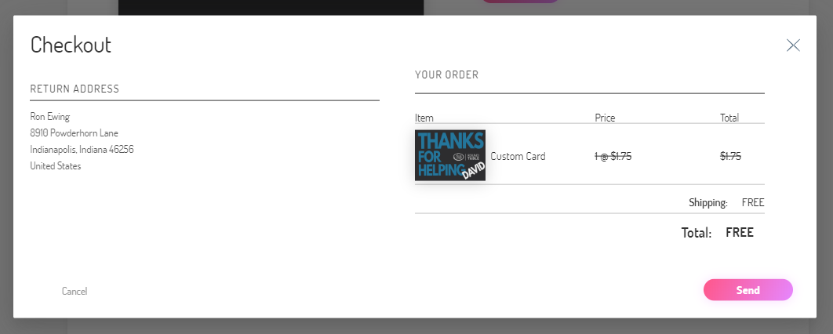
PROCESS

Slide 31
PROCESS
Done. Mailed.

Slide 32
ROUND TABLE
Eternal Business. Real Life.

