Slide 2
ROUND TABLE
Eternal Business. Real Life.

Slide 5
A BHAGG is something that you are trusting God to do in some area of your life - that is SO BIG that when it does happen - GOD and GOD alone can get the credit and glory for it.

Slide 6
A BHAGG is something that I couldn’t do on my own – even if I had 365 of my best days in a row – I STILL COULD NOT ACCOMPLISH THIS…

Slide 7
It is the type of thing where it is NOT UP TO YOU TO ACCOMPLISH.
It will take a supernatural act of God to make it happen.
A BHAG does not depend upon your work ethic, your education or business acumen, you figuring out how to do something, or putting a plan in place to make it happen.

Slide 8
There are a few key things to remember when establishing your BHAGs:
They must be so big only God can do them
They must stretch your faith –you have no idea how they can happen
They need to be specific-so that if and when they occur you will know it- there will be no chalking it up to a “coincidence”
You can “partner” with God in them-but He must make them happen. For example, if you are asking God for a loved one to trust Christ, you can (and should) pray for that to happen, you can even have conversations with that person, but only God can make the BHAG come true
You should not get frustrated if they do not occur-after all they are BHAGs-they are totally in God’s hands

Slide 9
A BHAGG is something that you are trusting God to do in some area of your life-that is SO BIG that when it does happen-GOD and GOD alone can get the credit and glory for it.
So what’s your BHAGG?
Personal? Family? Business?

Slide 10
Psalm 37:4 New King James Version (NKJV)
⁴ Delight yourself also in the Lord, And He shall give you the desires of your heart.

Slide 11
What do you do?
What are you options?
What does the Word of God say?

Slide 12
Big Take Away?
God's Power in Your Business - Pt1

Slide 13
What kinds of things do I need to START doing?
What kinds of things do I need to STOP doing?
God's Power in Your Business - Pt1

Slide 14
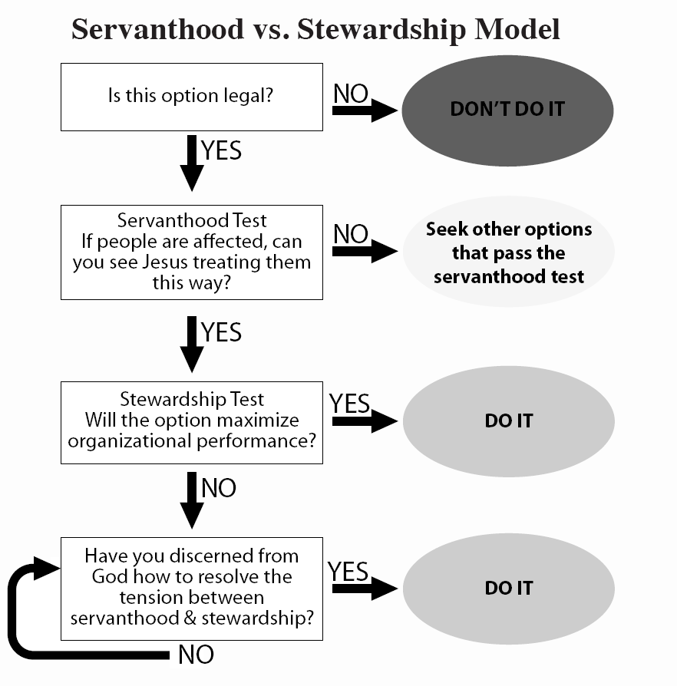
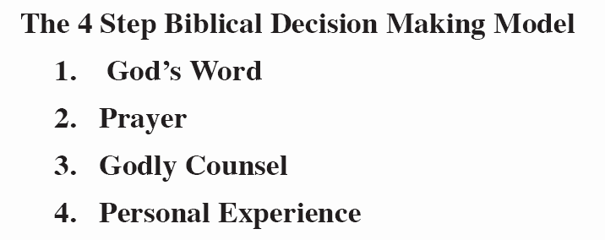
Two Models
Biblical Decision Making Models

Slide 15
“Christians at work in the world are the only real spiritual light in the midst of great darkness.” -Billy Graham
Bema Seat

