Slide 1
ROUND TABLE
Eternal Business. Real Life.

Slide 2
KNOW YOUR WHY

Slide 3
THE TWO GREATEST DAYS IN A MAN’S LIFE ARE THE DAY HE IS BORN AND THE DAY HE KNOWS WHY HE WAS BORN. [Attributed to Mark Twain, not confirmed]

Slide 4
OF ALL THE FUNERALS IN THE WORLD, WHY HAVE WE NOT BEEN TO YOURS?

Slide 5
“Joy comes from seeing the complete fulfillment of the specific purpose for which I was created and born again, not [just] from successfully doing something of my own choosing.” [- Oswald Chambers.]

Slide 6
“The place God calls you to is the place where your deep gladness and the world’s deep hunger meet.” [― Frederick Buechner, Wishful Thinking: A Theological ABC]

Slide 7
KNOW YOUR WHY

Slide 8
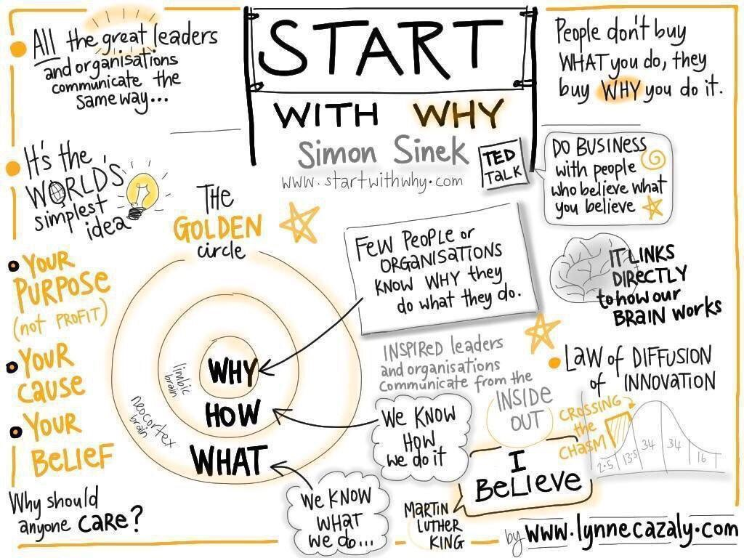
SIMON SINEK stumbled upon real truth in his book “Start With Why”
What he found was Part of God’s capitol ‘T’ TRUTH

Slide 9
KNOW YOUR WHY
PURPOSE / CAUSE / BELIEF / CALLING

Slide 10
“And I will give him a white stone, and on the stone a new name written which no one knows except him who receives it.” [REVELATION 2:17-18]
IS IT POSSIBLE THAT EVERY PERSON HAS A TRULY PERSONAL ‘WHY’ FROM GOD?
IN THE BOOK OF REVELATION GOD SHOWS US HOW PERSONAL HE IS TOWARDS US

Slide 11
KNOW YOUR WHY
PURPOSE / CAUSE / BELIEF / CALLING

Slide 12
GOD INVITES US TO PLAY A ROLE IN HIS STORY WHERE HE IS ALWAYS THE MAIN CHARACTER
WE INVITE GOD TO PLAY A ROLE IN OUR STORY WHERE WE ARE
THE MAIN CHARACTER

Slide 13
A Why
Outside
Of God’s
Why is
An Idol
WHAT’S YOUR
PERSONAL
WHY INSIDE
GOD’S
WHY
WHY
WHAT
HOW

Slide 14
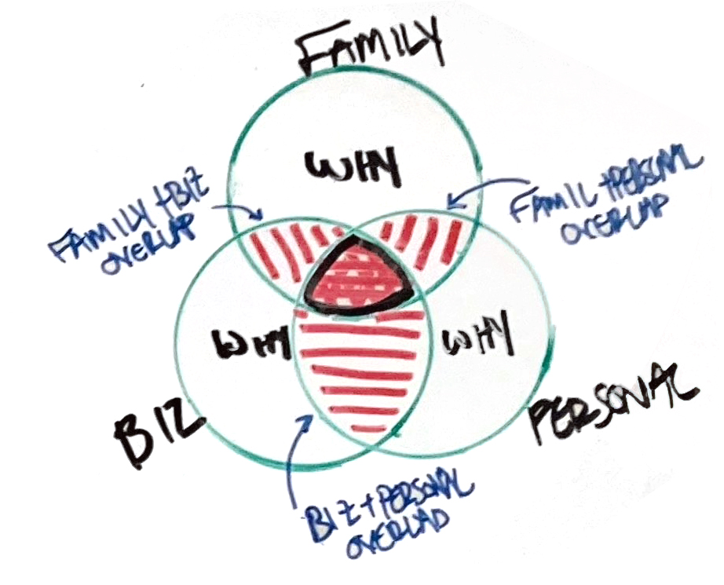
HOW DO WE DISCOVER THIS ‘WHY’
God Reveals it to Us
Through Faith
By Obedience
Knowing God (& His Character)
Walking in Your Identity in Christ
WHAT DOES THIS JOURNEY LOOK LIKE
Glorify God
Dominion Over Creation
Be Fruitful & Multiply
Know God
Make Him Known
Dwell With God
Preach the Gospel
Make Disciples

Slide 15
YOU MAY HAVE A ‘WHY’ IN DIFFERENT AREAS OF YOUR LIFE
GOD CAN REVEAL THAT THERE IS ACTUALLY ONE ‘WHY’ THAT APPLIES TO ALL AREAS OF YOUR LIFE

Slide 16
OBEDIENCE
FAITH
DOMINION OVER CREATION • BE FRUITFUL AND MULTIPLY
KNOW GOD • MAKE HIM KNOWN • BE WITH GOD
PREACH GOSPEL • GLORIFY GOD • MAKE DISCIPLE •
In Line With
THE CHARACTER OF GOD
In Line With
THE CHARACTER OF GOD
Walking in your
IDENTITY IN CHRIST

Slide 17
SO HOW DOES GOD REVEAL OUR WHY

Slide 18
WE PURSUE THE HEART OF GOD BY FAITH AND OBEDIENCE. UNDERSTANDING THE CHARACTER OF GOD AND OUR IDENTITY IN CHRIST HE REVEALS HIS SPECIFIC ‘WHY’

Slide 19
WAYS GOD REVEALS ‘WHY’ In His Whisper In His Word In His People In His Time

Slide 20
In His Whisper Listen Close for God’s Voice Less Noise Lean In / Draw Near Learn to Recognize Him

Slide 21
In His Word Read it Daily Read it Expectantly Read it Conversationally

Slide 22
In His People Unknowingly Subtly Thru their compliments Apparent Coincidence

Slide 23
In His Time Little by Little Reflecting on the Past Patiently With Perfect Timing

Slide 24
God’s WHY for your life… -crowd size -1v99 -inconvenience -timeline -invalidate

