Slide 1
WORK

Slide 2
In the beginning…

Slide 3
In the beginning…

Slide 4
In the beginning…
Then God blessed them, and God said to them, "Be fruitful and multiply; fill the earth and subdue it; have dominion over the fish of the sea, over the birds of the air, and over every living thing that moves on the earth."
Gen. 1:28
Then the Lord God took the man and put him in the garden of Eden to tend and keep it.
Gen 2:15

Slide 5
God’s design for work…
God is calling those who are SKILLED:
He is calling those whose heart is WILLING:
He wants our work to be an OFFERING:
Exodus 35:10 'All who are gifted artisans among you shall come and make all that the Lord has commanded
Exodus 35:21 Then everyone came whose heart was stirred, and everyone whose spirit was willing,
Exodus 35:25 brought what they had

Slide 6
God’s design for work…
He wants to BLESS our work with His SPIRIT:
He wants to BLESS/TEACH others in your WORK:
Exodus 35:30-33 And Moses said to the children of Israel, "See, the Lord has called by name Bezalel the son of Uri, the son of Hur, of the tribe of Judah; and He has filled him with the Spirit of God, in wisdom and understanding, in knowledge and all manner of workmanship, to design artistic works, to work in gold and silver and bronze, in cutting jewels for setting, in carving wood, and to work in all manner of artistic workmanship.
Exodus 35:34 And He has put in his heart the ability to teach, in him and Aholiab the son of Ahisamach, of the tribe of Dan.

Slide 7
GOD CREATED WORK

Slide 8
If God created it, then it is
HOLY

Slide 9
Nothing is SECULAR
“There is no neutral ground in the universe; every square inch, every split second, is claimed by God and counter-claimed by Satan” – C.S. Lewis

Slide 10
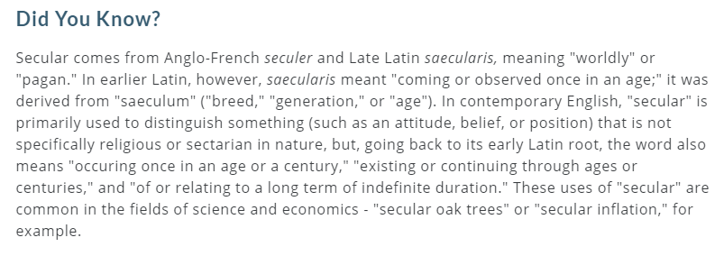
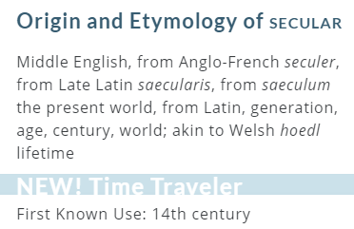
SECULAR
Whoever is not with me is against me, and whoever does not gather with me scatters. -Matthew 12:30

Slide 11
GOD CREATED WORK

Slide 12
If God created it then it is
HOLY

Slide 13
CALLED
All are
By God

Slide 14
And we know that all things work together for good to those who love God, to those who are the called according to His purpose. For whom He foreknew, He also predestined to be conformed to the image of His Son, that He might be the firstborn among many brethren. Moreover whom He predestined, these He also called; whom He called, these He also justified; and whom He justified, these He also glorified.
ROMANS 8:28-30

Slide 15
CALLED
All are

Slide 16
God’s call to make DISCIPLES is universal to all believers, not just for those who work at church.

Slide 17
VOCARE

Slide 18
VOCARE
calling

Slide 19
VOCARE
calling
vocation

Slide 20
Vocation is just what we do for
WORK

Slide 21
And whatever you do, do it heartily, as to the Lord and not to men, knowing that from the Lord you will receive the reward of the inheritance; for you serve the Lord Christ.
Colossians 3:23-24

Slide 22
EXCELLENCE

Slide 23
EXCELLENCE
INFLUENCE

Slide 24
EXCELLENCE
INFLUENCE
CHANGE CULTURE

Slide 25
WORK
CALLING

Slide 26
AVODAH

Slide 27
AVODAH
work

Slide 28
AVODAH
work
worship

Slide 29
WORK
CALLING
WORSHIP

Slide 30
Why God chose work?
Access - Relationship
Time - Proximity
Life Invades

Slide 31
Per a study:
70% of people interviewed admitted to having a spiritual conversation in the last 24 hours at work.
They are already talking about…

Slide 32
2 questions

Slide 33
Two questions
Do you in your heart of hearts believe, really believe, that you and your place in life are every bit as HOLY as that of your pastor or any other leader in church?
1

Slide 34
Two questions
Deep down in the very CORE of your being, do you see yourself, and what you do for work (or school), just as important to GOD as what goes on in church?
2

Slide 35
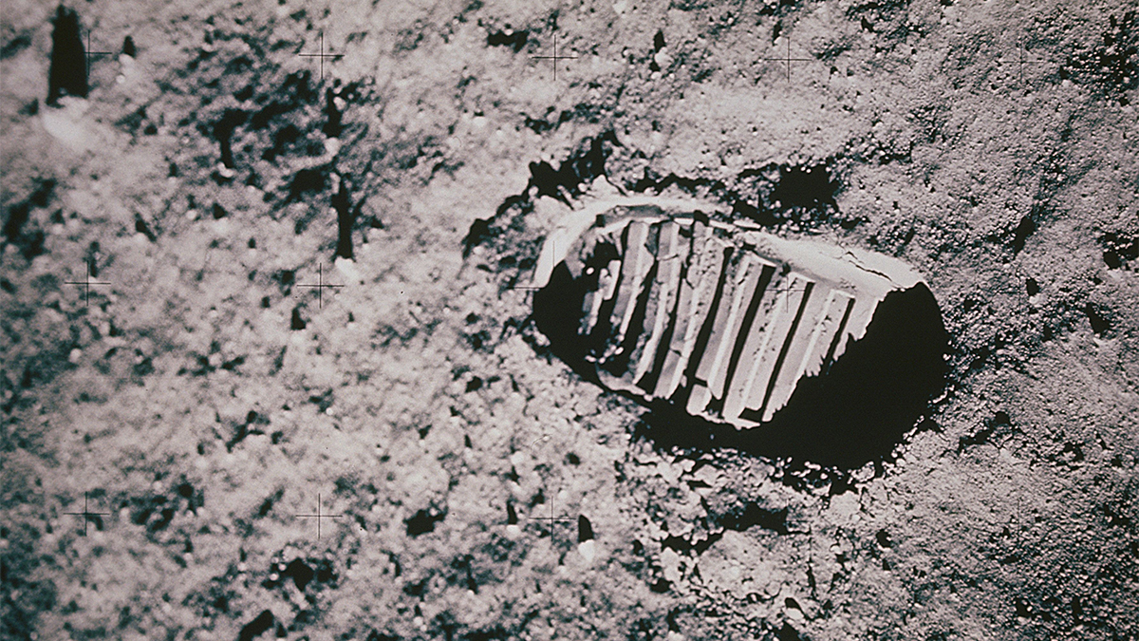

Slide 36
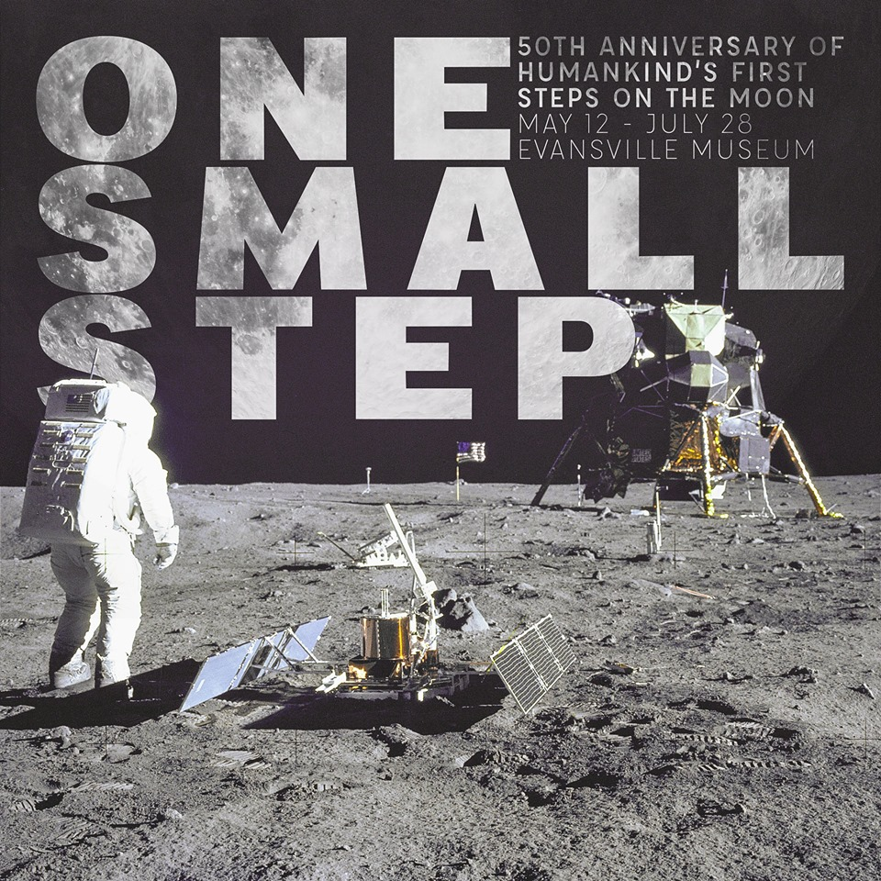

Slide 37
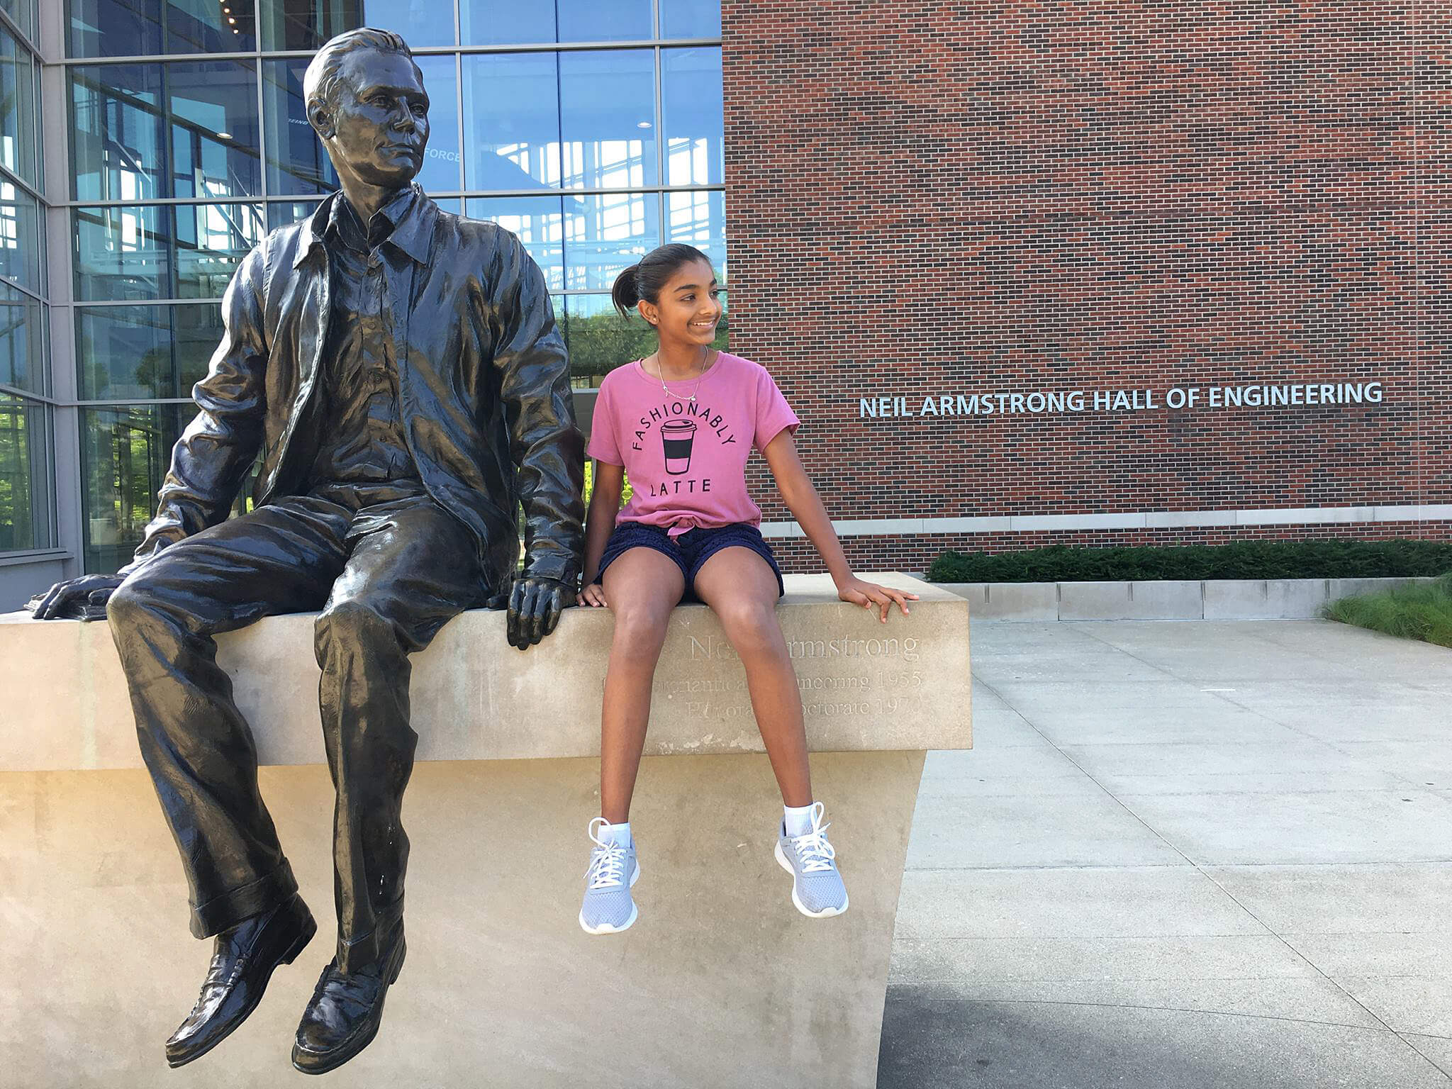

Slide 38
50 years ago he walked on the moon.
Today he met the One who made the moon.
What about your steps?

Slide 39
EVERY STEP YOU TAKE GOD HAS CALLED YOU INTO WORK AS WORSHIP

Slide 41
UNDERCOVER
UNDER SUSPICION
UNDENIABLE

Slide 42
What keeps us from discussing it?
“We fear AWKWARD conversations more than death”
-Francis Chan

